Slide 1


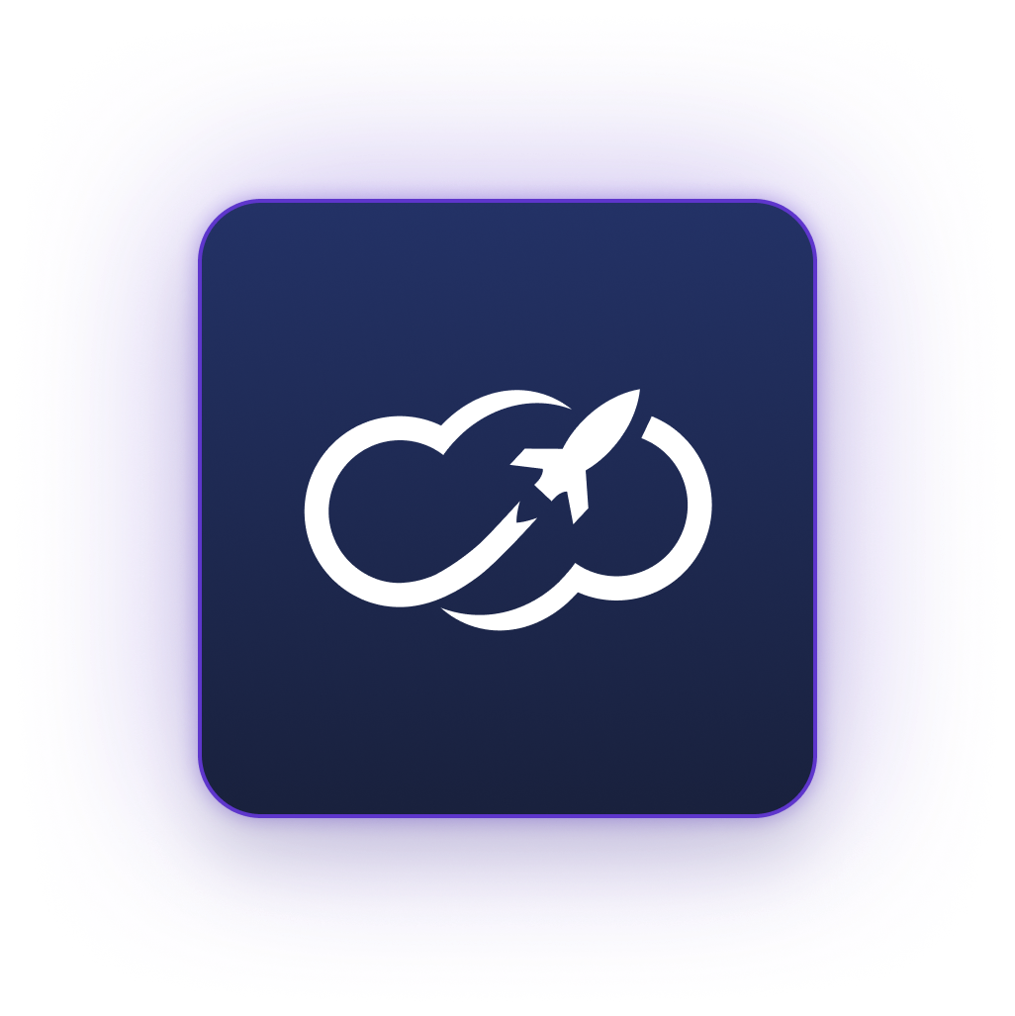
From Code to Cloud
Building Resilient Infrastructure with IaC and Automated Deployments
Roman Schwarz & Melody Sofia Eroshevich
Notes:
🟢

Slide 2


&
Roman Schwarz
Melody Sofia Eroshevich
Senior Site Reliability Engineer
Site Reliability Engineer & Community Lead
CLOUDETEER.DE
Notes:
🟢 → 🟣

Slide 3

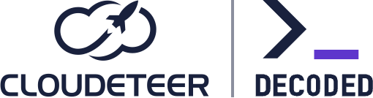


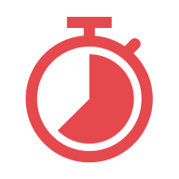

Incidents
Missing Policy caused Production Risk
Provider Update caused Massive Change
Manual Hotfix caused Silent Drift
A missing policy integration
allowed an insecure configuration (open security group) into production. The issue bypassed review and required a rollback.
A missing lock file and loose provider constraints (v1.*) triggered a provider upgrade, making a small code change produce a huge, unexpected Terraform plan.
Manual remediation in the cloud console introduced drift. Because Terraform state was unaware, a later terraform apply reverted the fix, causing a repeat outage.
From Code to Cloud | by Roman and Melody
CLOUDETEER.DE | 03/19
Notes:
🟣

Slide 4

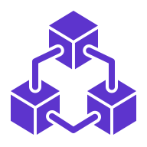

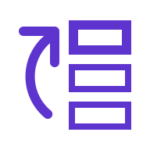

Resilience in IaC
Consistency
Auditability
Reversibility
Small Blast Radius
Dev, QA, and production should run identical code paths and modules — no snowflakes.
Every plan, approval, and policy must be stored, visible, and reviewable at any time.
Always keep a safe rollback path to restore a known good state if needed.
Split deployments into smaller units so one failure or lock doesn’t block the whole platform.
From Code to Cloud | by Roman and Melody
CLOUDETEER.DE | 04/19
Notes:
🟣

Slide 5

Incident 1
Missing Policy caused Production Risk
Provider Update caused Massive Change
Manual Hotfix caused Silent Drift
A missing policy integration
allowed an insecure configuration (open security group) into production. The issue bypassed review and required a rollback.
A missing lock file and loose provider constraints (~> 1.0) triggered a provider upgrade, making a small code change produce a huge, unexpected Terraform plan.
Manual remediation in the cloud console introduced drift. Because Terraform state was unaware, a later terraform apply reverted the fix, causing a repeat outage.
From Code to Cloud | by Roman and Melody
CLOUDETEER.DE | 05/19
Notes:
🟢

Slide 6










Delivery Architecture
Pipeline
Lint
{ }
Linting and static scanning — fast checks to catch errors and bad practices.
Pipeline
Engineer
Apply
Engineer
Scan
Pipeline applies the approved plan.
Security scanning — detects vulnerabilities and misconfigurations early.
Review
Git
Reviewers check code and plan for accuracy and compliance.
Infra
Source of truth. Every commit triggers the pipeline.
Infrastructure is updated.
Policy
Approval
Policy gate — enforces organizational rules before planning.
Human approval required per environment before apply.
Plan
Preview all infrastructure changes safely before apply — reviewers see intended actions.
From Code to Cloud | by Roman and Melody
CLOUDETEER.DE | 06/19
Notes:
🟢

Slide 7




Policy & Security Gates
TFLint
Trivy
Conftest
Note
Static Rules
Security Scanning
Organization Policies
Looking to craft custom security rules? Try Checkov — a great companion (or rival) to Trivy, depending on your mood.
From Code to Cloud | by Roman and Melody
CLOUDETEER.DE | 07/19
Notes:
🟢

Slide 8
Approvals & Promotions
Test
Automated or manual tests verify the change.
Reject
Approve
After tests pass, final approval precedes production deployment.
Implement
Developers write and commit code changes.
Review
Reviewers examine the plan artifact, not just the code.
Deploy
The approved plan or code is deployed to staging.
Production
Promote
Implement
Review
Deploy
Audit Trail
From Code to Cloud | by Roman and Melody
CLOUDETEER.DE | 08/19
Notes:
🟢

Slide 9

Incident 2
Missing Policy caused Production Risk
Provider Update caused Massive Change
Manual Hotfix caused Silent Drift
A missing policy integration
allowed an insecure configuration (open security group) into production. The issue bypassed review and required a rollback.
A missing lock file and loose provider constraints (~> 1.0) triggered a provider upgrade, making a small code change produce a huge, unexpected Terraform plan.
Manual remediation in the cloud console introduced drift. Because Terraform state was unaware, a later terraform apply reverted the fix, causing a repeat outage.
From Code to Cloud | by Roman and Melody
CLOUDETEER.DE | 09/19
Notes:
🟣

Slide 10

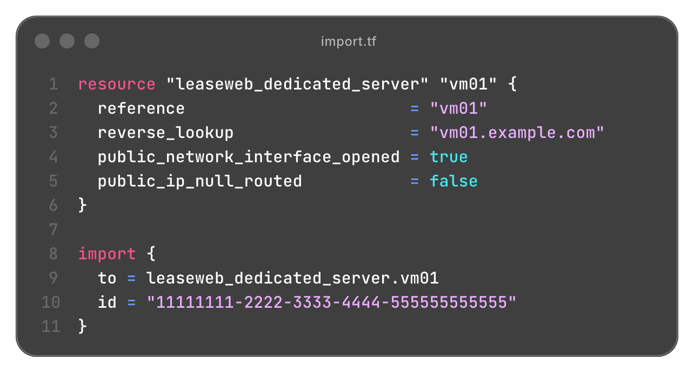
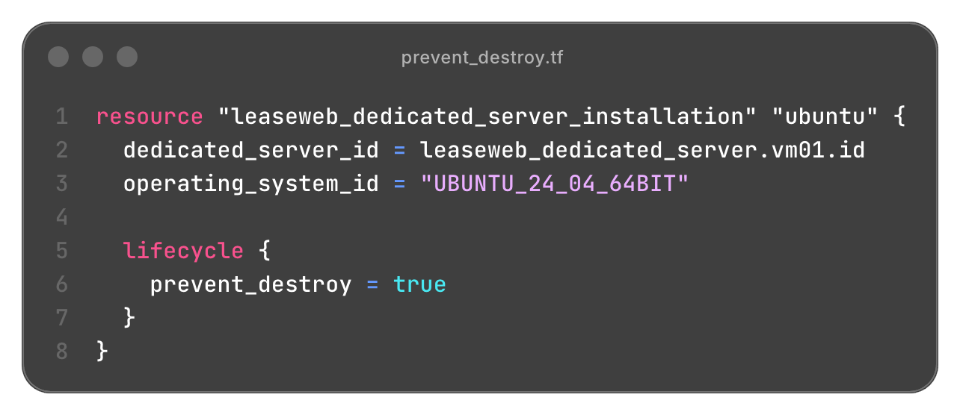
Import & Prevent Destroy
Note
Terraform 1.5+ can automatically generate configuration during import — so you might not even need to write it yourself anymore. Let Terraform do the typing.
From Code to Cloud | by Roman and Melody
CLOUDETEER.DE | 10/19
Notes:
🟣

Slide 11
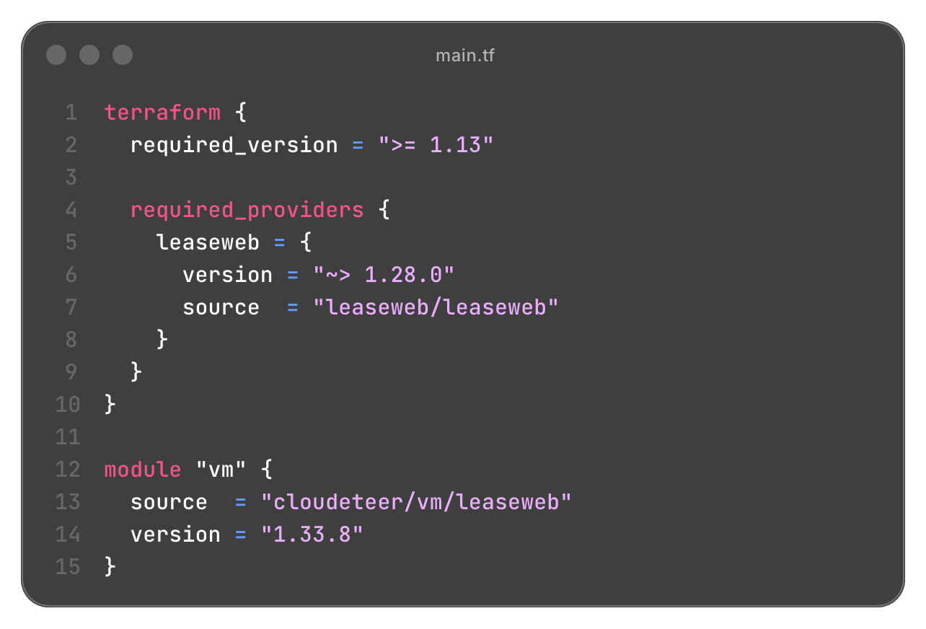
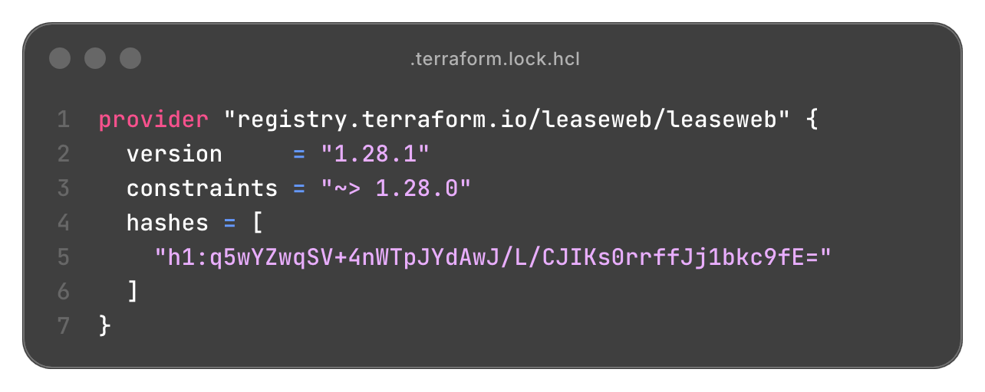
Versioning
Note
In the wild, it happens way too often: teams forget to commit the .terraform.lock.hcl file. That’s a no-go. Lock it in — so your deployments stay predictable, not adventurous.
From Code to Cloud | by Roman and Melody
CLOUDETEER.DE | 11/19
Notes:
🟣

Slide 12




Module Testing Workflow
Git / PR
CI/CD
Review/Merge
Release
Review & Publish
Semantic Versioning
Predictable Releases
terraform test
Static Analysis
Security Scan
Documentation Validation
Confirm correct version constraints
Avoid breaking changes
Final step: Release
Automatic Semantic Versioning
From Code to Cloud | by Roman and Melody
CLOUDETEER.DE | 12/19
Notes:
🟣

Slide 13

Incident 3
Missing Policy caused Production Risk
Provider Update caused Massive Change
Manual Hotfix caused Silent Drift
A missing policy integration
allowed an insecure configuration (open security group) into production. The issue bypassed review and required a rollback.
A Terraform missing lock file and loose provider constraints triggered a provider upgrade, making a small code change produce a huge, unexpected Terraform plan.
Manual remediation in the cloud console introduced drift. Because Terraform state was unaware, a later terraform apply reverted the fix, causing a repeat outage.
From Code to Cloud | by Roman and Melody
CLOUDETEER.DE | 13/19
Notes:
🟢

Slide 14
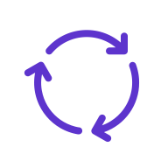

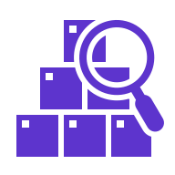

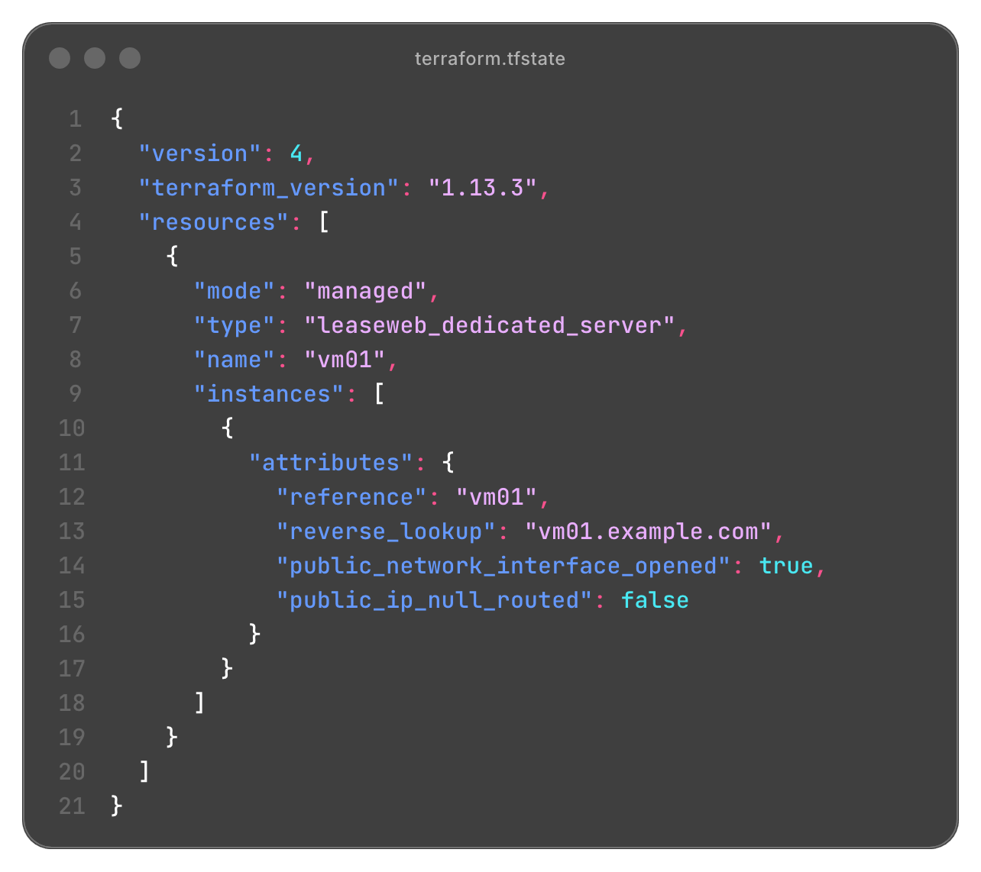


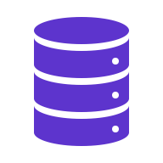



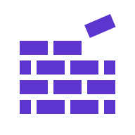
Scheduled Drift Detection
Scheduled Pipeline
Terraform State
Infrastructure
Recurring
Automated
Detect Drift
Notify
$ terraform plan -refresh-only || notify.sh
From Code to Cloud | by Roman and Melody
CLOUDETEER.DE | 14/19
Notes:
🟢

Slide 15


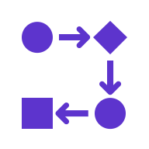










State & Locking
Single State on Developer Machine
Shared State with Locking Mechanism
No collaborative development
No central pipeline
Pipeline
Pipeline
Engineer
Remote State Backend
State
(versioned)
From Code to Cloud | by Roman and Melody
CLOUDETEER.DE | 15/19
Notes:
🟢

Slide 16
Field Notes
Missing Policy caused Production Risk
Provider Update caused Massive Change
Manual Hotfix caused Silent Drift
Policy is the First Line of Defence
Version Control is Risk Control
Detect, Don’t Assume
Automate security and compliance — policies remember what humans forget.
Lock your provider versions — consistency is the foundation of resilience.
Continuously detect drift — awareness prevents costly recovery.
A missing policy integration
allowed an insecure configuration (open security group) into production. The issue bypassed review and required a rollback.
A missing lock file and loose provider constraints (~> 1.0) triggered a provider upgrade, making a small code change produce a huge, unexpected Terraform plan.
Manual remediation in the cloud console introduced drift. Because Terraform state was unaware, a later terraform apply reverted the fix, causing a repeat outage.
From Code to Cloud | by Roman and Melody
CLOUDETEER.DE | 16/19
Notes:
🟣

Slide 17



Key Takeaways
Design for control, not for speed
Version and verify everything.
Detect early, recover fast.
Build systems that remember.
From Code to Cloud | by Roman and Melody
CLOUDETEER.DE | 17/19
Notes:
🟢

Slide 18
References
Resource | Description / Purpose | Link
CLOUDETER DECODED Blog | Engineering blog by Cloudeteer with deep dives into cloud technologies and infrastructure automation. | https://engineering.cloudeteer.de/
CLOUDETEER Terraform Modules | Official Cloudeteer Terraform modules for reusable infrastructure components. | https://registry.terraform.io/namespaces/cloudeteer
Leaseweb Terraform Provider | Terraform provider for managing LeaseWeb infrastructure. | https://registry.terraform.io/providers/LeaseWeb/leaseweb/
Terraform Docs & Guides | Official HashiCorp Terraform documentation and learning resources. | https://developer.hashicorp.com/terraform
Trivy | Security scanner for containers, IaC, and dependencies. | https://trivy.dev/
TFLint | Linter for Terraform code to detect errors and enforce best practices. | https://github.com/terraform-linters/tflint
Conftest | Tool for testing configuration files using Open Policy Agent (OPA). | https://www.conftest.dev/
Checkov | Static analysis tool for scanning IaC for security and compliance misconfigurations. | https://www.checkov.io/
From Code to Cloud | by Roman and Melody
CLOUDETEER.DE | 18/19
Notes:
🟢

Slide 19
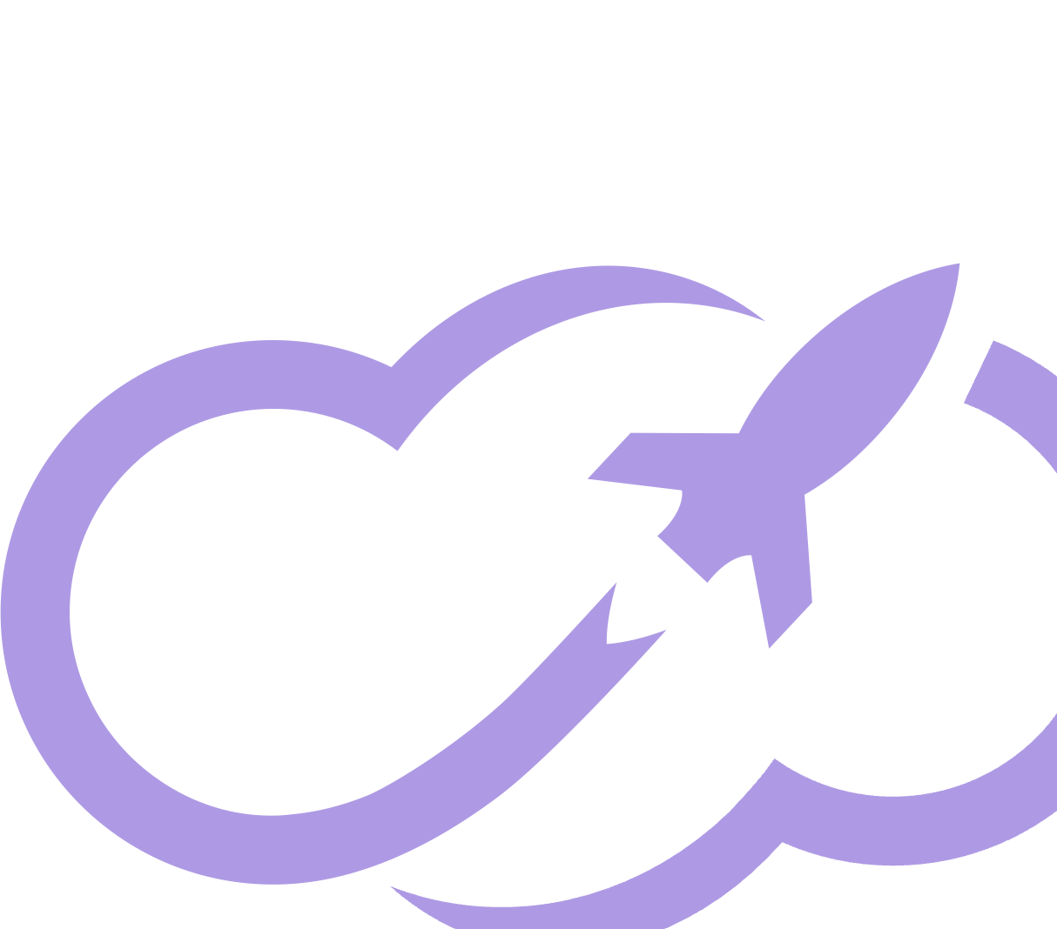

EOF
Thank you for listening.
Your attention and engagement means a lot.
LinkedIn
https://www.linkedin.com/showcase/cloudeteer-decoded/
Email
engineering@cloudeteer.de
Notes:
🟣

